Slide 1
Common Electrolyte Imbalances and their Management
Prof. Quazi Tarikul Islam FCPS, FACP, FRCP(Edin. Glasg.) Professor of Medicine

Slide 2
Electrolytes
Elements or minerals found in bodily fluids that become electrically charged particles (cations or anions)
Responsible for many activities of the body including heart automaticity, nerve impulses, movement of water and fluids, and chemical reactions
Allow cells to generate energy and maintain cell wall stability
Hormones produced by the kidneys and adrenal glands control most electrolyte levels

Slide 3
Reasons for Electrolyte Imbalances
Abnormalities occur when electrolyte concentrations are imbalanced between intercellular and extracellular fluids
Kidney Dysfunction
Lack of Water: Dehydration or Diarrhea
Medication Side Effects

Slide 4
SODIUM

Slide 5
SODIUM, Basic Info
Regulates water distribution and fluid balance through entire body
Normal Levels
Extracellular level: 135-145 mEq/L
Intracellular level: 10-12 mEq/L

Slide 6
SODIUM, Basic Info Sodium imbalances normally related to changes in total body water, not changes in sodium. Sodium imbalances can lead to hypovolemia or hypervolemia.

Slide 7
HYPONATREMIA LOW SODIUM

Slide 8
Signs/Symptoms Low Sodium
Headache, lethargy, confusion
Mild anorexia, nausea, abdominal discomfort
Muscle cramps, weakness
Mental status changes, decreased level of consciousness
Seizures, tremors
Orthostatic vital signs

Slide 9
Hyponatremia: Causes
Hypovolemia
Extra-renal sodium loss (Una<10)
Sweat, diarrhea, vomiting
3rd spacing: trauma, burns, pancreatitis
Renal sodium loss (Una >20)
Diuretics
Mineralocorticoid deficiency
Cerebral salt wasting
Proximal type II RTA
Euvolemia (Una>20)
SIADH
Glucocorticoid deficiency
Hypothryoidism
Psychogenic polydipsia
Drugs: desmopressin, psychoactive agents, chemotx

Slide 10
Hyponatremia: Causes
Hypervolemia (Una<20)
Acute or chronic renal failure Una>20
Congestive heart failure
Cirrhosis/hepatic failure
Nephrotic syndrome
Hyperosmolar
Hyperglycemia, mannitol, glycine

Slide 11
SIADH
Causes
Intracranial pathology, mechanical ventilation, post-operative, malignancy, neck surgery, pulmonary pathology
Diagnosis
Patient should be euvolemic
Labs: Serum osm, Urine osm, Una
Urine will be inappropriately concentrated for a patient who is hypoosmolar
Urine Na will be elevated and Urine output will be low
Treatment
3% NS
Fluid restriction to 30-50% maintenance
Avoid excess free water-->make sure to check drips!

Slide 12
Hyponatremia: Therapy
Correct rapidly with 3% NS for severely symptomatic patients
4ml/kg 3%NS will increase [Na] by 5
Normalize sodium at a rate of 8-12 mEq/L over 24 hours with 0.45% or 0.9% NS
Central pontine myelinolysis
may be irreversible
dysarthria, dysphagia, spastic paresis, coma
Check frequent sodiums (q1 or q2h)
Notes:
Hyponatremia can be acute or chronic--which necessitates getting a good patient history. Rapid correction of chronic hyponatremia increases the risk of central pontine myelinolysis because neurons do not have time to generate idiogenic osmoles.

Slide 13
3% NS
Characteristics
513 mEq/L
pH= 5.0
1027 mosm/L
Can be administered peripherally (in the acute setting) or centrally (recommended)
3-5 ml/kg will raise serum sodium by 4-6 mEq/L
Adverse effects
Metabolic acidosis and hyperchloremia
Venous irritation/phlebitis

Slide 14
IV Fluid to Correct Hyponatremia
Correct Sodium at rate of .5mEq/L per hour if no symptoms present
Elevate Sodium by 4-6mEq/L in first 2 hours if symptoms are present
No more than 10-12mEq/L in first 24 hours and no more than 18mEq/L in first 48 hours

Slide 15
HYPERNATERMIA HIGH SODIUM

Slide 16
High Sodium: Hypernatremia
Very rare to see over 145mEq/L, 50% of cases are fatal at that level
Leads to intercellular dehydration because water follows sodium into extracellular spaces
More common in very young
Women who have poor nutrition have poor milk production for their newborns

Slide 17
Signs/Symptoms High Sodium
Restlessness, change in mental status, irritability, seizure activity
Nausea, vomiting, increased thirst
Ataxia, tremors, hyper-reflexia
Flushed skin, increased capillary refill time
Decreased cardiac output related to decreased myocardial contractility

Slide 18
Causes of Hypernatremia
Usually associated with dehydration--there is too little water.
Water loss can occur from vomiting and/or diarrhea, excessive sweating, or from drinking fluid with high salt concentrations.
Decreased thirst drive: elderly, dementia patients, newborns
Decreased water intake--leads to free water deficit--leads to high sodium
Diabetes Insipidus

Slide 19
Diabetes Insipidus
An uncommon condition when the kidneys are unable to concentrate urine or conserve water. The amount of water conserved is controlled by antidiuretic hormone, also called vasopressin.
Symptoms: polyuria, excessive thirst, inappropriately dilute urine (urine osmolality < serum osmolality)
Lab Tests: urinalysis and strict I&O measurement
Treatment: The cause of the underlying condition should be treated when possible. May be controlled with vasopressin pills or nasal spray.

Slide 20
 | SIADH | CSW | DI central | Post resus diuresis
Body water | Increased | decreased | decreased | Normal or increased
Sodium | low | low | high | normal
Serum osm | <280mOsm/L | decreased | >300mOsm/L | Normal (280-290mOsm/L)
Urine osm | >500mOsm/L | increased | decreased | variable
Urine to serum osm ratio | >1 | >1 | <1.5 | variable
Urine output | low | high | high | high
Urine sodium | increased | increased | decreased | variable

Slide 21
Interventions/Treatments for High Sodium
Need to determine and treat underlying cause
Get good IV access
Send blood work to lab
Increase sodium intake orally or correct with hypotonic sodium IV fluids
.45%NS allows slower reduction of sodium levels than D5

Slide 22
POTASSIUM

Slide 23
POTASSIUM, Basic Info
Most concentrated inside the cells
Regulates muscle tissue contractility, including heart muscle
Helps control cellular metabolism: converts glucose to glucagon for muscle fuel
Regulated by kidneys; excess levels removed by feces and sweat
Serum potassium levels controlled by Sodium-Potassium Pump (pumps sodium out of cells and allows potassium back into cells)
Normal Levels
Serum level: 3.5-5.0 mEq/L

Slide 24
HYPOKALEMIA LOW POTASSIUM

Slide 25
Signs and Symptoms of Low Potassium
Muscle weakness, aches, cramping, paresthesias
Confusion, fatigue, syncope, hallucinations
Low blood pressure
Palpitations
Polyuria and UA with low specific gravity
ECG CHANGES: U waves, increased QT interval, flat T wave, depressed ST segment

Slide 27
Causes of Hypokalemia
Nausea/Vomiting/Diarrhea
Diabetic ketoacidosis
Laxative abuse
Diuretic medications
High corticosteroid levels
Insulin use (can cause shift of K+ out of blood and into cells)
Magnesium deficiency
Medicines used for asthma or COPD (beta-adrenergic agonist drugs)
Acute kidney failure
High aldosterone levels

Slide 28
Cushing’s Disease
A condition where the pituitary gland releases too much adrenocorticotropic hormone (ACTH), usually due to a tumor. ACTH stimulates the production and release of cortisol, a stress hormone. Too much ACTH = too much cortisol.
Symptoms: upper body obesity with thin arms and legs, round full face (moon face), collection of fat between the shoulders (buffalo hump), excess hair growth on the face or neck or chest, irregular menstrual cycle, decreased sexual desire, depression, anxiety, fatigue, frequent headaches, hypertension.
Lab Tests to confirm elevated cortisol levels. Testing is then done to determine the cause.
Treatment: Radiation treatment or surgery to remove the pituitary gland tumor. If the tumor does not respond to surgery or radiation, medications can be used to slow cortisol production but will need to be taken for life.

Slide 29
Interventions/Treatments for Low Potassium
Need to determine and treat underlying cause
Get good IV access--send blood work and UA to lab
Increase potassium intake orally or correct with IV fluid
NEVER give K+ by IV push!!

Slide 30
Mild or Moderately Low Potassium Level (2.5-3.5 mEq/L) | Low Potassium Level (less than 2.5 mEq/L) | Severely Low Potassium Level (less than 2.0 mEq/L)
no symptoms, or only minor complaints | if cardiac arrhythmias or significant symptoms are present
treat with liquid or pill potassium--preferred because it is easy to administer, safe, inexpensive, and readily absorbed from the gastrointestinal tract. | IV potassium should be given--admission or observation in the hospital is indicated. Replacing potassium takes several hours as it must be administered very slowly intravenously to avoid problems. | both IV potassium and oral medication are necessary

Slide 31
IV Treatment of Low Potassium per UofM CVC ICU Protocol Guidelines
Serum potassium concentration | Intravenous potassium dose† | Recheck serum potassium concentration
3.8 – 3.9 mEq/L | 20 mEq potassium intravenously | 2 hours after completing dose
3.5 – 3.7 mEq/L | 40 mEq potassium intravenously | 2 hours after completing dose
3.2 – 3.4 mEq/L | 50 mEq potassium intravenously | 2 hours after completing dose
2.9 – 3.1 mEq/L | 60 mEq potassium intravenously | Immediately after completing dose
< 2.9 mEq/L | 80 mEq potassium intravenously and notify MD | Immediately after completing dose

Slide 32
† Rate of Intravenous Potassium Infusion | 10 mEq potassium/hour; can increase to 20 mEq/hour, but continuous cardiac monitoring and infusion via a central venous catheter are recommended for infusion rates > 10 mEq potassium/hour.
Maximum Potassium Concentration | 80 mEq/L via a peripheral vein; up to 120 mEq/L via a central vein (admixed in NS or ½ NS)

Slide 33
HYPERKALEMIA HIGH POTASSIUM

Slide 34
Signs and Symptoms High Potassium
Can be life threatening if high K+ causes a potentially life-threatening heart rhythm
ECG changes: peaked T waves, prolonged PR interval, wide QRS complex
Nausea
Fatigue
Muscle weakness, tingling sensation
Bradycardia
Weak pulses

Slide 35
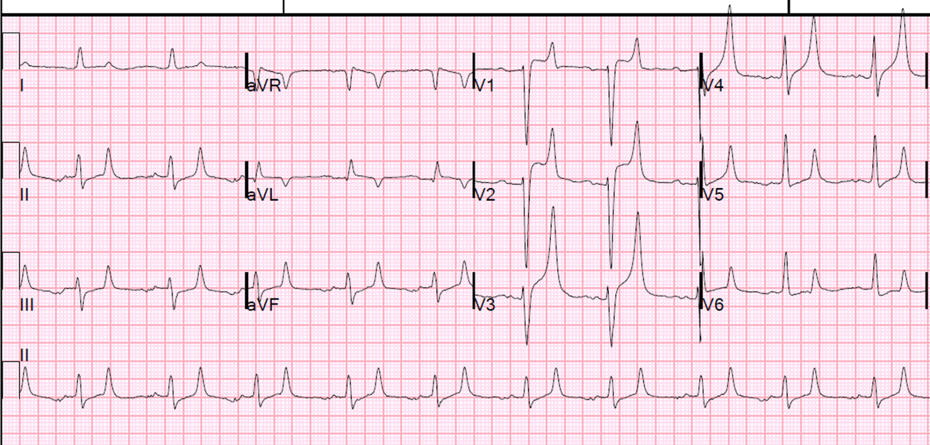

Slide 36
Causes of Hyperkalemia
Often related to renal issues (acute failure, stones, inflammation, transplant rejection, etc). K+ levels build up because it can’t be excreted in the urine.
Using potassium supplements (RX or OTC)
Medications: Steroid use, NSAID use, some diuretic use, ACE Inhibitors
Severe burns or trauma injuries
Overuse of salt substitutes
Rhabdomyolysis
Metabolic Acidosis or Ketoacidosis (the acidosis and high glucose levels work together to cause fluid and potassium to move out of the cells into the blood circulation)

Slide 37
Addison’s Disease
A disorder that occurs when the adrenal glands do not produce enough hormones. Hormones, such as aldosterone, regulate sodium and potassium balance.
Symptoms: changes in blood pressure or heart rate, fatigue and weakness, nausea and vomiting and diarrhea, skin changes—darkening or paleness, loss of appetite, salt craving, unintentional weight loss.
Lab Tests: increased potassium, low serum sodium levels, hypotension, low cortisol level.
Treatment: replacement corticosteroids will control the symptoms; patients often receive a combination of glucocorticoids (cortisone or hydrocortisone) and mineralocorticoids (fludrocortisone).

Slide 38
Interventions/Treatments for High Potassium
Restrict medication use
IV diuretics, such as Lasix: to decrease the total K+ stores by increasing K+ excretion in the urine
Kayexalate: binds K+ and leads to its excretion via the gastrointestinal tract.
With high levels, a special IV cocktail is often used: calcium gluconate (to protect the heart), sodium bicarbonate (to alkalinize the plasma and help move potassium into the cells), IV dextrose (to attract the potassium), IV insulin (to force the glucose into the cells and the potassium will follow)
Continuous cardiac monitoring and frequent vital signs

Slide 39
CALCIUM

Slide 40
CALCIUM, Basic Info
About 99% of the body's calcium is stored in the bones, but cells (especially muscle cells) and blood also contain calcium.
Essential for: formation of bone and teeth, muscle contraction, nerve signaling, blood clotting, normal heart rhythm
Calcium levels are regulated primarily by two hormones: parathyroid hormone and calcitonin
Normal Levels
Serum level: 8.6-10.4 mg/dL

Slide 41
HYPOCALCEMIA LOW CALCIUM

Slide 42
Signs and Symptoms Low Calcium
Increased neuromuscular irritation:
Chvostek’s Sign (tapping on the facial nerve causes twitching of facial muscles)
Trousseau’s Sign (inflating the BP cuff for several minutes causes muscular contractions, including flexion of the wrist and metacarpophalangeal joints)
ECG Changes: prolonged QT interval, heart block, VT
Depression, dementia, anxiety, mental status changes
Hypotension
Diaphoresis
Bronchospasm, Stridor
Bone Pain, Fractures, Osteomalacia, Rickets

Slide 43
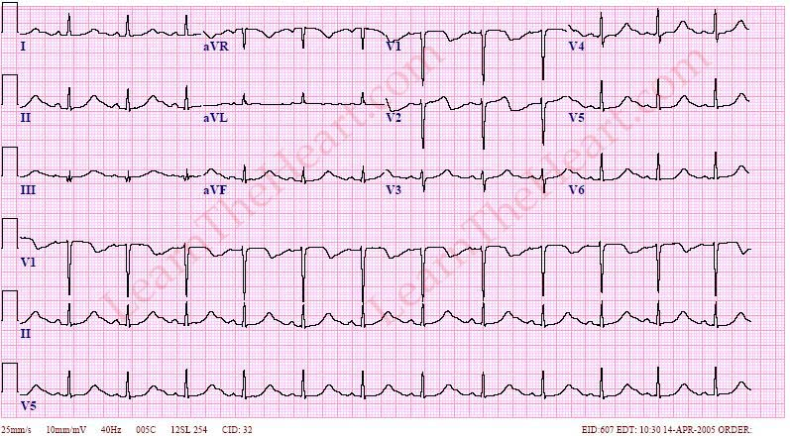

Slide 44
Positive Trousseau’s Sign

Slide 45
Positive Chvostek’s Sign

Slide 46
Causes of Hypocalcemia
Hypoparathyroidism
Hyperphosphatemia
Chronic Renal Failure
Pancreatitis
Sepsis
Liver disease (decreased albumin production)
Osteomalacia
Malabsorption (inadequate absorption of nutrients from the intestinal tract)
Vitamin D deficiency or Magnesium deficiency

Slide 47
Hypoparathyroidism
An endocrine disorder where the parathyroid glands do not produce enough parathyroid hormone (PTH).
PTH helps control calcium, phosphorus, magnesium, and vitamin D levels within the blood and bone.
Blood calcium levels fall, and phosphorus levels rise.
The most common cause is injury to the glands.
Sometimes can be caused as a side effect of radioactive iodine treatment for hyperthyroidism.
May lead to stunted growth, malformed teeth, and slow mental development in children.

Slide 48
Hyperphosphatemia
Phosphorous is critical for bone mineralization, cellular structure, and energy metabolism.
Causes hypocalcemia by precipitating calcium, decreasing vitamin D production, and interfering with parathyroid hormone-mediated bone reabsorption.
Considered significant when levels are greater than 5 mg/dL in adults or 7 mg/dL in children.
Patients commonly complain of muscle cramping that may lead to tetany, delirium, and seizures.

Slide 49
Intervention/Treatments for Low Calcium
Seizure Precautions
IV Calcium Gluconate (1-2 grams over 20 minutes) with Vitamin D (calcitriol). (Precautions are taken to prevent seizures or laryngospasms. The heart is monitored for abnormal rhythms until the patient is stable.)
1 GM Calcium Gluconate = 90mg elemental Calcium = 4.5 mEq Ca++
Oral Calcium (1-3 grams per day) with oral Vitamin D
Sunlight Therapy

Slide 50
HYPERCALCEMIA HIGH CALCIUM

Slide 51
Signs and Symptoms High Calcium
Fatigue, lethargy
ECG Changes: increased PR interval, short QT interval
Depression, paranoia, hallucinations, coma
Polyuria, flank pain, kidney stone formation
Decreased neuromuscular excitability: (hyporeflexia, weakness, poor coordination)
Decreased GI Motility: nausea, vomiting, constipation, hypoactive bowel sounds

Slide 52
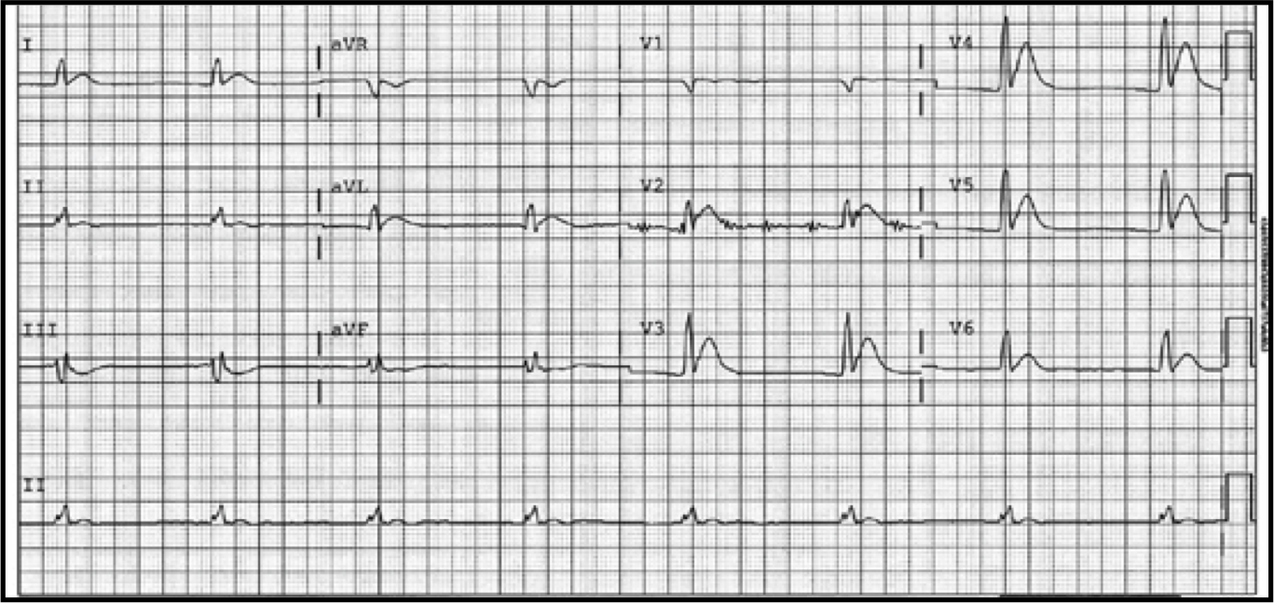
Osborn Wave

Slide 53
Causes of Hypercalcemia
90% of cases caused by Hyperparathyroidism or Malignancy
Addison's disease
Paget's disease
Vitamin D intoxication
Excessive calcium intake (dairy foods), also called Milk-Alkali Syndrome
Hyperthyroidism or too much thyroid hormone replacement medication
Prolonged immobilization
Sarcoidosis
Use of certain medications such as lithium, tamoxifen, and thiazide diuretics

Slide 54
Hyperparathyroidism
Most common cause of high calcium
Due to excess PTH release by the parathyroid. (PTH raises serum calcium levels while lowering the serum phosphorus concentration.)
Serum calcium is elevated and bones lose calcium.
Surgical removal of the affected gland(s) is the most common cure.

Slide 55
Addison’s Disease
A disorder that occurs when the adrenal glands do not produce enough hormones. Hormones, such as aldosterone, regulate sodium and potassium balance.
Symptoms: changes in blood pressure or heart rate, fatigue and weakness, nausea and vomiting and diarrhea, skin changes—darkening or paleness, loss of appetite, salt craving, unintentional weight loss.
Lab Tests: increased potassium, low serum sodium levels, hypotension, low cortisol level.
Treatment: replacement corticosteroids will control the symptoms; patients often receive a combination of glucocorticoids (cortisone or hydrocortisone) and mineralocorticoids (fludrocortisone).

Slide 56
Paget's Disease
A chronic skeletal disorder which may result in enlarged or deformed bones in one or more regions of the skeleton.
Involves abnormal bone destruction followed by irregular bone regrowth--results in deformities and weakness.
The new bone is bigger, but weakened and filled with blood vessels.

Slide 57
Intervention/Treatments for High Calcium
Bisphosphonates--first line treatment--prevent bone breakdown and increase bone density. It may take 3 months or longer before bone density begins to increase. (ex: Fosamax, Actonel)
.9NS IV leads to natriuresis which leads to increased Calcium excretion
Calcitonin--when taken by shot or nasal spray, will slow the rate of bone thinning. (ex: Miacalcin, Calcimar)
Lasix--promotes fluid and Calcium excretion

Slide 58
MAGNESIUM

Slide 59
Magnesium, Basic Info
Magnesium is the fourth most abundant mineral in the body.
50% of total body magnesium is found in bone. 50% is found inside cells of body tissues and organs.
Only 1% of magnesium is found in blood.
Magnesium helps maintain normal muscle and nerve function, supports healthy immune system, promotes normal blood pressure, involved in energy metabolism, and is needed to move other electrolytes (potassium and sodium) in and out of cells.
Stimulates the parathyroid glands to secrete parathyroid hormone. If these glands don’t produce sufficient hormones, the level of calcium in the blood will fall
Normal Levels
Serum level: 1.7-2.6 mEq/L

Slide 60
HYPOMAGNESEMIA LOW MAGNESIUM

Slide 61
Signs/Symptoms Low Magnesium
Causes neuromuscular irritability and irregular heartbeats
Laryngospasm, hyperventilation
Apathy, mood changes, agitation, confusion
Insomnia, anxiety
Anorexia, nausea, vomiting
Tremors, hyper-reflexia, leg cramps, muscle weakness
Seizures
Magnesium deficiency has been associated with hypokalemia, hypocalcemia, and cardiac arrhythmias

Slide 62
Causes of Hypomagnesemia
Magnesium deficiency is often associated with low blood calcium and/or low potassium
Irritable Bowel Syndrome, Ulcerative Colitis—because magnesium is absorbed in the intestines and then transported through the blood to cells and tissues
Alcoholism, withdrawal from alcohol
Hypoparathyroidism
Malnutrition, Inadequate intake of mineral
Kidney disease
Pancreatitis
Medications--Diuretics (increases loss of magnesium through urine), Digitalis, Cisplatin, Cyclosporine
Large amounts of magnesium can be lost by prolonged exercise, excessive sweating, or chronic diarrhea

Slide 63
Hypoparathyroidism
An endocrine disorder where the parathyroid glands do not produce enough parathyroid hormone (PTH).
PTH helps control calcium, phosphorus, magnesium, and vitamin D levels within the blood and bone.
Blood calcium levels fall, and phosphorus levels rise.
The most common cause is injury to the glands.
Sometimes can be caused as a side effect of radioactive iodine treatment for hyperthyroidism.
May lead to stunted growth, malformed teeth, and slow mental development in children.

Slide 64
Intervention/Treatment for Low Magnesium
Seizure Precautions
Magnesium Sulfate
25-50mg/kg/dose for replacement
30-60mg/kg/day for maintenance
IV dose exceeding 2 grams must be given over 120 minutes via pump
500mg Mg Sulfate = 49.3 mg elemental Mg = 4.06 mEq Mg++
Doses exceeding 2 grams must be infused over 60-120 minutes!

Slide 65
HYPERMAGNESEMIA HIGH MAGNESIUM

Slide 66
Signs and Symptoms High Magnesium
Too much magnesium depresses the nervous system and breathing and produces neuromuscular and heart effects.
Hypotension, bradycardia
Diaphoresis, flushing
Drowsiness, decreased mental status
Decreased heart rate, tall T wave, ventricular dysrhythmias
Hyporeflexia, weakness, paralysis

Slide 67
Causes Hypermagnesemia
Dehydration
Addison’s Disease or other adrenal gland disease
Hyperparathyroidism
Hypothyroidism
Kidney Failure
Acute Acidosis

Slide 68
Intervention/Treatment for High Magnesium
Circulatory and respiratory support
1 gram Calcium Gluconate (to reverse s/s including respiratory depression)
Administration of IV Lasix to increase magnesium excretion (only when renal function is adequate)
Hemodialysis may be used in severe hypermagnesemia because approx 70% of serum magnesium is not protein bound and can be removed through dialysis.

Slide 69
Thank You

